Slide 1

SEMINAR REPORT
ON
‘Taipei 101’
D. Y. PATIL COLLEGE OF ENGINEERING
DEPARTMENT OF CIVIL ENGINEERING
AKURDI, PUNE – 411044, INDIA
Submitted by
Abheek khajuria
Guided by
Mrs.P.G.Kalasur

Slide 2
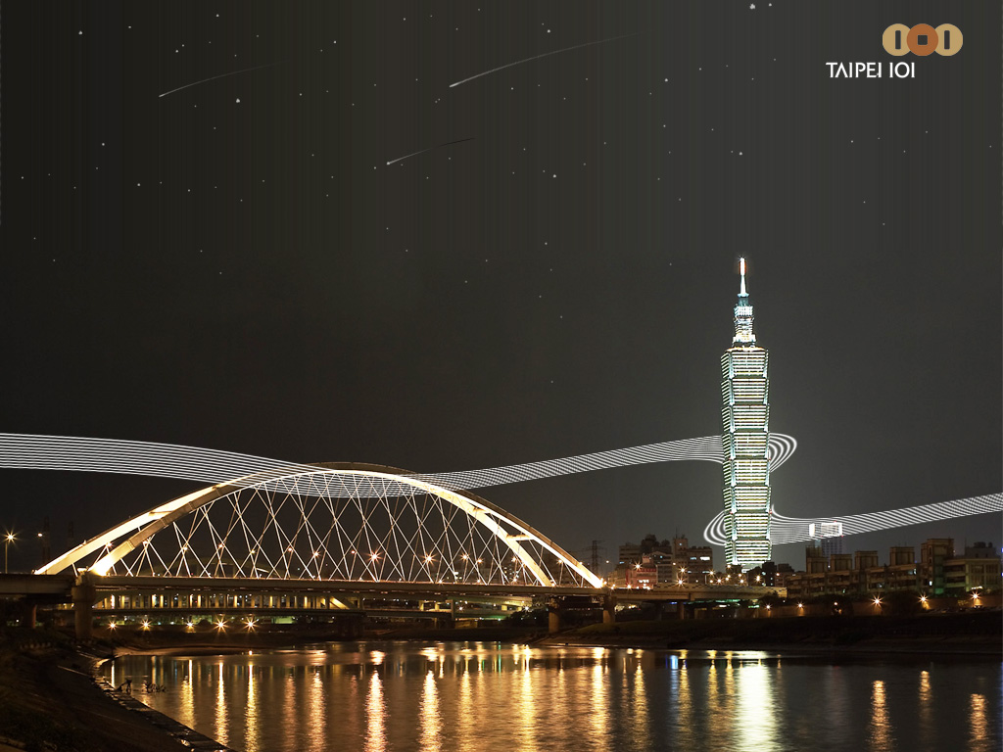
A Building With A Difference

Slide 3
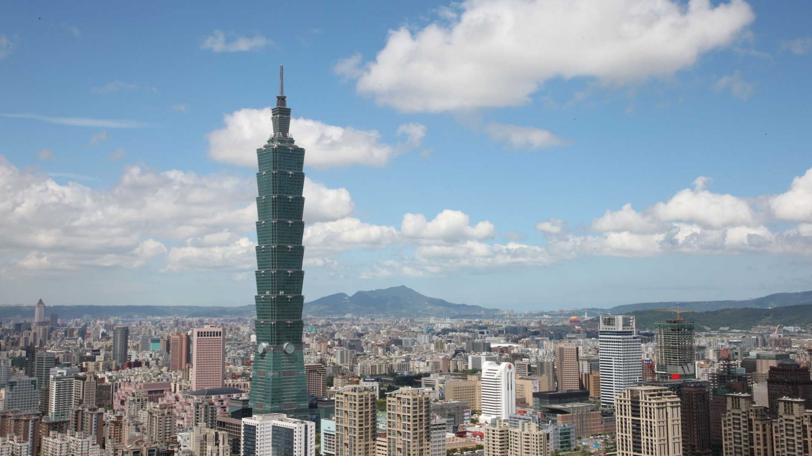
Tallest in the world from 2004 to 2010

Slide 4
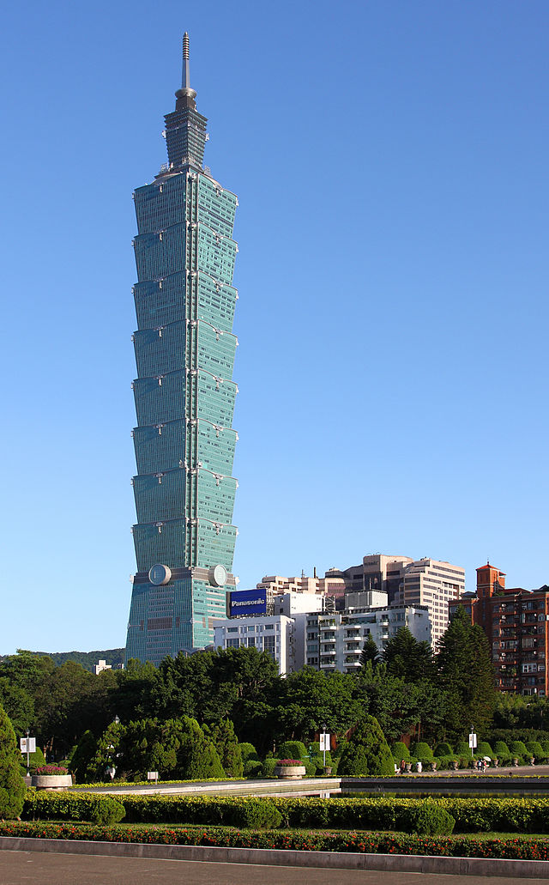
One of the tallest and largest green building in the world

Slide 5
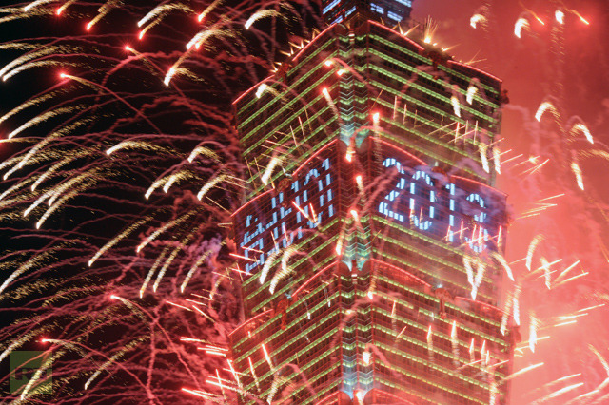
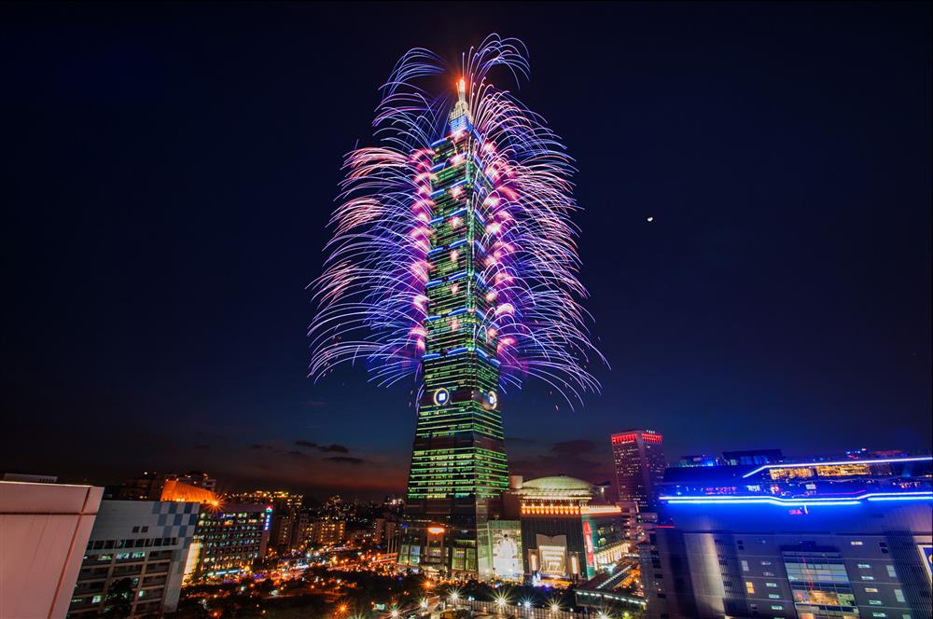
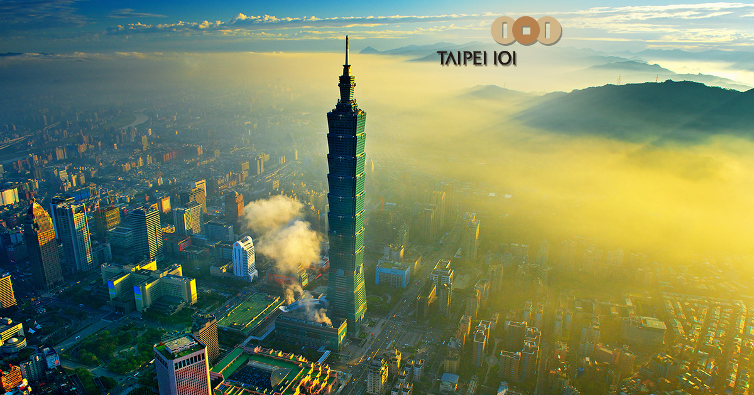
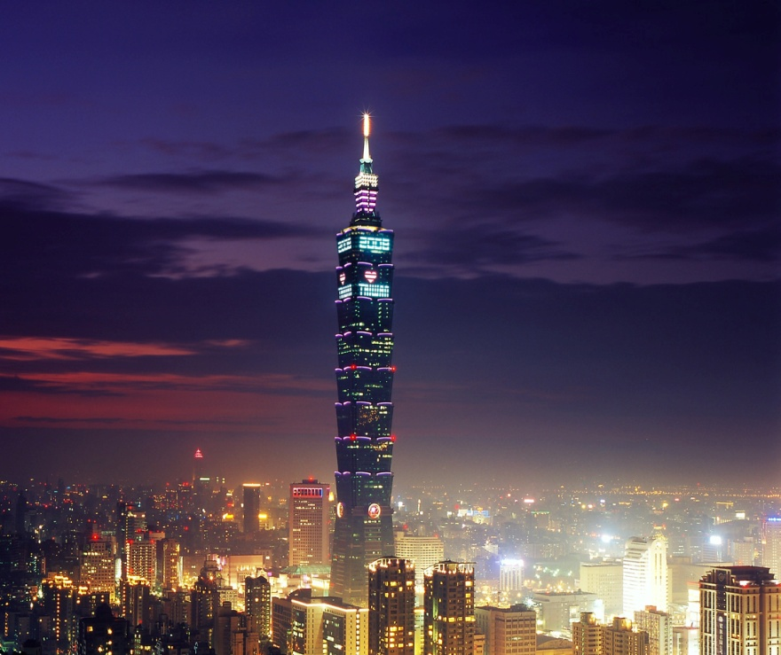
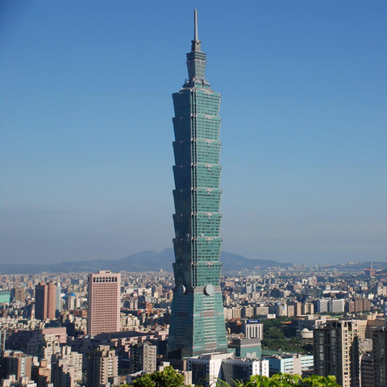
Taipei 101

Slide 6
Introduction
Taipei 101 , formerly known as the Taipei World Financial Centre, is a landmark super tall skyscraper in Xinyi District, Taipei, Taiwan. The building was officially classified as the world's tallest in 2004, and remained such until the opening of Burj Khalifa in Dubai in 2010.
In July 2011, the building was awarded the LEED Platinum certification, the highest award according the Leadership in Energy and Environmental Design (LEED) rating system, and became the tallest and largest green building in the world.
Taipei 101 was designed by C.Y. Lee & partners and constructed primarily by KTRT Joint Venture.
. The construction started in 1999 and finished in 2004. The tower has served as an icon of modern Taiwan ever since its opening.

Slide 7
Taipei 101 comprises 101 floors above ground and 5 floors underground. The building was architecturally created as a symbol of the evolution of technology and Asian tradition.
Its postmodernist approach to style incorporates traditional design elements and gives them modern treatments.
The tower is designed to withstand typhoons and earthquakes. A multi-level shopping mall adjoining the tower houses hundreds of stores, restaurants and clubs.
Taipei 101 is owned by Taipei Financial Centre Corp. (TFCC) and managed by the International division of Urban Retail PropertiesCorporation based in Chicago.

Slide 8
Height
The Taipei 101 tower has 101 floors above ground and five underground. Upon its completion Taipei 101 claimed the official records for:
Ground to highest architectural structure : 508 m (1,667 ft). Previously held by the Petronas Towers 451.9 m(1,483 ft).
Ground to roof: 449.2 m (1,474 ft). Formerly held by the Willis Tower 442 m (1,450 ft).
Ground to highest occupied floor: 438 m (1,437 ft). Formerly held by the Willis Tower 412.4 m (1,353 ft).
Fastest ascending elevator speed: designed to be 1,010 meters per minute, which is 16.83 m/s (55.22 ft/s) (60.6 kilometres per hour (37.7 mph)).
Largest countdown clock: Displayed on New Year's Eve.
Tallest sundial.

Slide 9
Taipei 101 was the first building in the world to break the half-kilometer mark in height. The record it claimed for greatest height from ground to pinnacle was surpassed by the Burj Khalifa in Dubai (UAE), which is 829.8 m (2,722 ft) in height.
Taipei 101's records for roof height and highest occupied floor briefly passed to the Shanghai World Financial Centre in 2009, which in turn yielded these records as well to the Burj.
Taipei 101 displaced the Petronas Towers in Kuala Lumpur, Malaysia, as the tallest building in the world by 56.1 m (184 ft).
Various sources, including the building's owners, give the height of Taipei 101 as 508.0 m (1,667 ft), roof height and top floor height as 448.0 m (1,470 ft) and 438.0 m (1,437 ft). This lower figure is derived by measuring from the top of a 1.2 m (4 ft) platform at the base.

Slide 10
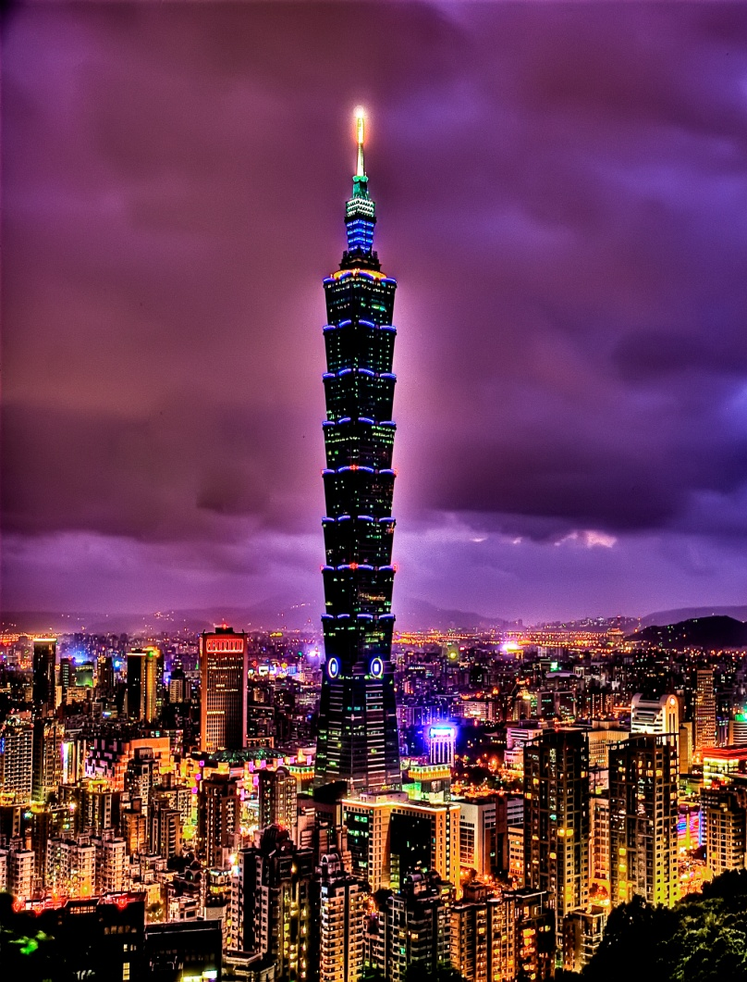
Basic Information
Architect – C.Y.Lee & Partners
Structural Engineer – Shaw Shieh
Structural Consult. – Thornton-Tomasetti Engineers, New York City
Year Started – June 1998
Total Height – 508m
No. of Floors – 101
Plan Area – 50m X 50m
Cost – $ 700 million
Building Use – Office Complex + Mall
Parking - 83,000 m2, 1800 cars
Retail - Taipei 101 Mall (77,033 m2)
Offices - Taiwan Stock Exchange (198,347 m2)

Slide 11
Building Frame
Materials
60ksi Steel
10,000 psi Concrete
Systems
Outrigger Trusses
Moment Frames
Belt Trusses
Lateral Load Resistance
Braced Moment Frames in the building’s core
Outrigger from core to perimeter
Perimeter Moment Frames
Shear walls
Basement and first 8 floors

Slide 12
Structural Design
Taipei 101 is designed to withstand the typhoon winds and earthquake tremors common in its area of the Asia-Pacific.
Planners aimed for a structure that could withstand gale winds of 60 m/s (197 ft/s, 216 km/h or 134 mph) and the strongest earthquakes likely to occur in a 2,500 year cycle.
Skyscrapers must be flexible in strong winds yet remain rigid enough to prevent large sideways movement.
Flexibility prevents structural damage while resistance ensures comfort for the occupants and protection of glass, curtain walls and other features.
Most designs achieve the necessary strength by enlarging critical structural elements such as bracing. The height of Taipei 101 combined with the demands of its environment called for additional innovations. The design achieves both strength and flexibility for the tower through the use of high-performance steel construction.
Thirty-six columns support Taipei 101, including eight "mega-columns" packed with 10,000 psi (69 MPa) concrete.
Every eight floors, outrigger trusses connect the columns in the building's core to those on the exterior.

Slide 13
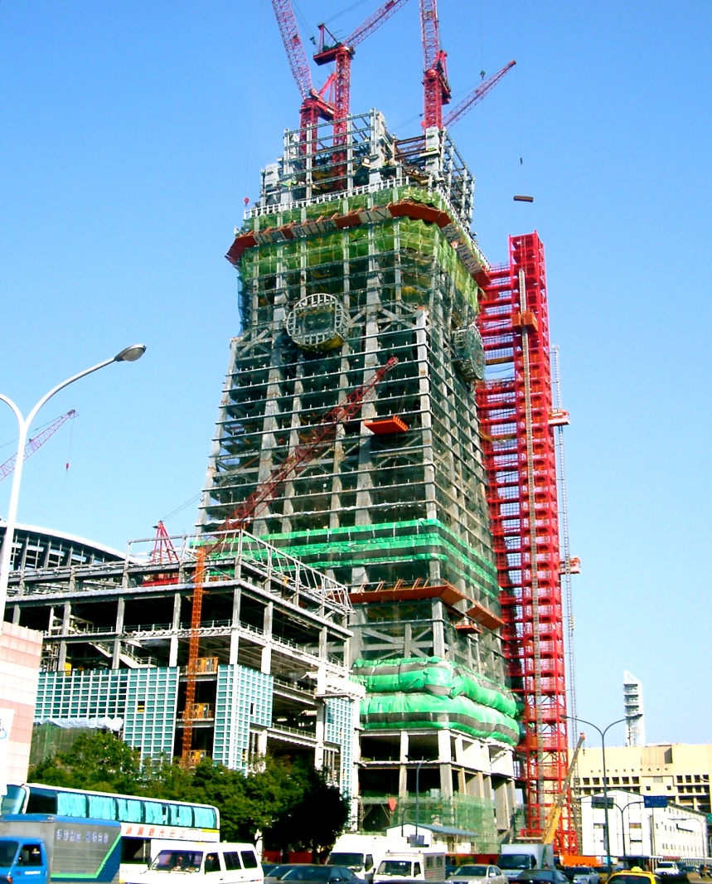
These features combine with the solidity of its foundation to make Taipei 101 one of the most stable buildings ever constructed.
The foundation is reinforced by 380 piles driven 80 m (262 ft) into the ground, extending as far as 30 m (98 ft) into the bedrock.
Each pile is 1.5 m (5 ft) in diameter and can bear a load of 1,000–1,320 tonnes (1,100–1,460 short tons).
The stability of the design became evident during construction when, on 31 March 2002, a 6.8-magnitude earthquake rocked Taipei. The tremor was strong enough to topple two construction cranes from the 56th floor, the highest floor at the time.
Five people died in the accident, but an inspection showed no structural damage to the building, and construction soon resumed.

Slide 14
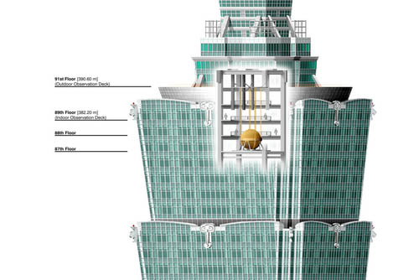
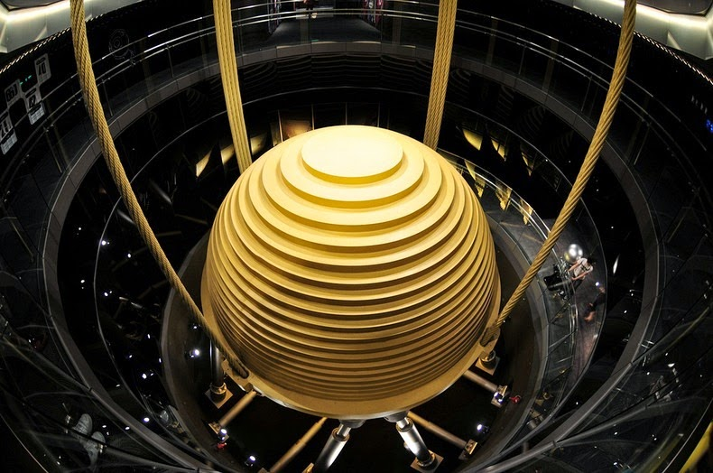
Thornton-Tomasetti Engineers along with Evergreen Consulting Engineering designed a 660-tonne (728-short-ton) steel pendulum that serves as a tuned mass damper, at a cost of NT$132 million (US$4 million).
Suspended from the 92nd to the 87th floor, the pendulum sways to offset movements in the building caused by strong gusts.
Its sphere, the largest damper sphere in the world, consists of 41 circular steel plates of varying diameters, each 125 mm (4.92 in) thick, welded together to form a 5.5 m (18 ft) diameter sphere.
Two additional tuned mass dampers, each weighing 6 tonnes (7 short tons), are installed at the tip of the spire which help prevent damage to the structure due to strong wind loads.

Slide 15
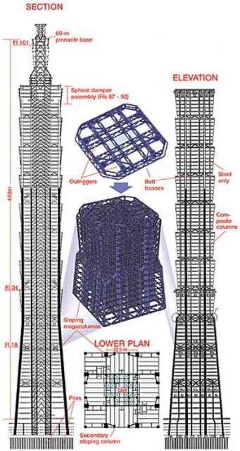
Construction
380 piles with 3 inch concrete slab.
Mega columns- 8 cm thick steel & 10,000 psi concrete infill to provide for overturning.
Walls - 5 & 7 degree slope.
106,000 tons of steel, grade 60- 25% stronger.
6 cranes on site – steel placement.
Electrical & Mechanical.
Braced core with belt trusses
Curtain wall placement.

Slide 16
The structure concentrates main loads in two, generally 3 x 2.4-m vertical mega columns, 22.5 m apart along each face, almost touching the sloping perimeter wall at its base. Main floor girders connect each mega column through moment connections with a core corner column along the same gridline, forming a tick-tack-toe board .The 22.5-m-square core comprises 16 box columns in four lines, which are generally fully braced between floors. Composite floors are typically 13.5 cm thick.
At equipment floors every eighth level, outriggers connect mega columns and the core. Outriggers are generally formed by vertically bracing main floor girders above and below equipment floors. Further cross bracing between main perimeter columns at these levels forms belt trusses around the tower. Two minor outriggers connect the core’s central columns with sloping H-shaped uprights in each module’s face.
From just below level 26 down, mega columns slope with the building’s profile. Two, 2 x 1.2-m columns are added toward the centre of each facade, while each corner is supported by an additional 1.4-m-square sloping box column.

Slide 17
Corner columns are tied to the main frame with two-story-deep belt trusses under levels 9, 19 and 27. All other sloping mega columns are connected to core columns with double-story outriggers at these levels.
Designed for axial loads up to 38,000 tonnes, main mega columns are made of steel as thick as 8 cm. Along with the core elements, mega columns are filled with 10,000-psi reinforced concrete up to level 62. Additional box columns below floor 26 are also filled.
For enhanced resistance to seismic forces, main girders and the facade framework have welded connections to the mega columns. For additional ductility, key main beams have reduced flange widths next to column welds.
The design criteria are tougher than needed to comply with local codes, says Shieh. Codes require the frame to stay elastic in a 100-year shock and remain upright through a 950-year event. But actual capabilities are better, claims Shieh. The building is engineered to stay up under a 2,500-year shock

Slide 18
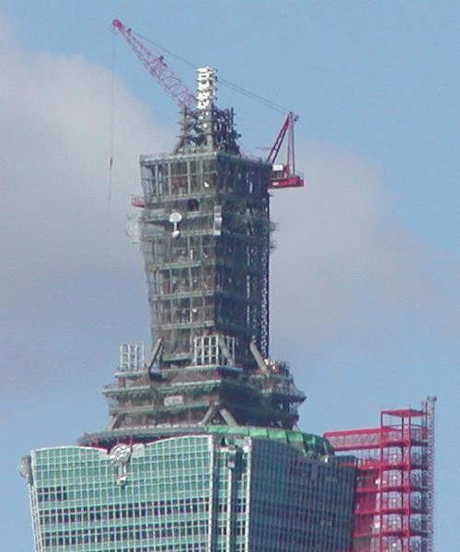
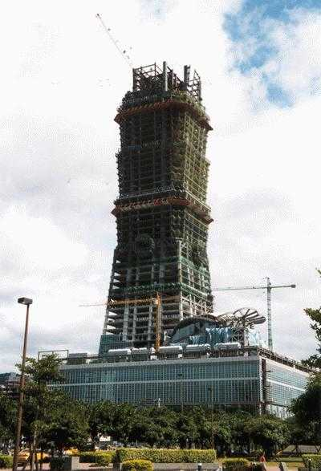

Slide 19
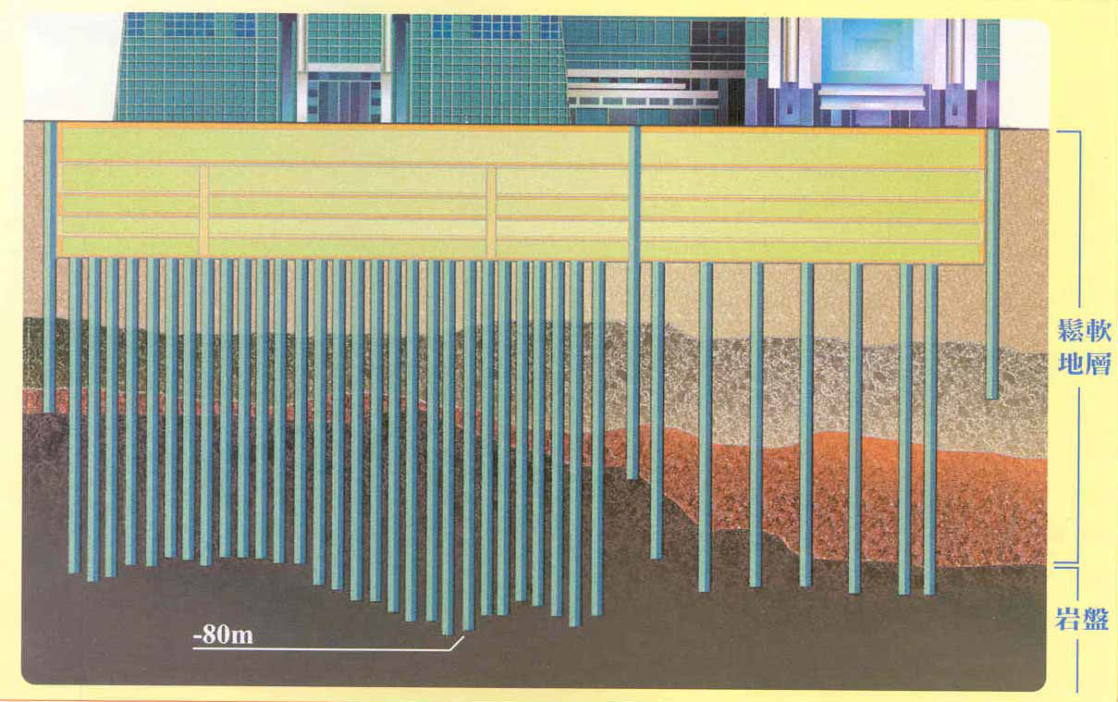
Foundation
The building is a pile through clay rich soil to bedrock 60-80m below.
The plies are topped by a foundation slab which is 3m thick at the edges and up to 5m thick under the largest of columns
There are a total of 380 1.5m dia. Tower piles.

Slide 20
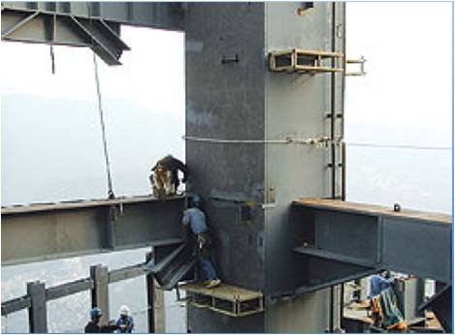
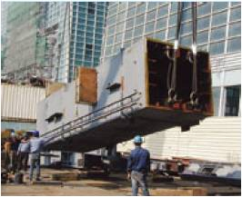
Column System

Slide 21
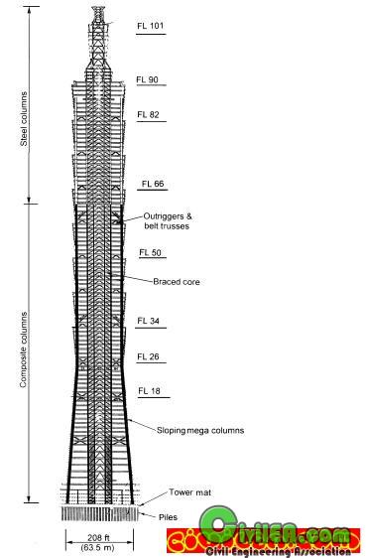
Gravity loads are carried vertically by a variety of columns.
Within the core, sixteen columns are located at the crossing points of four lines of bracing in each direction.
The columns are box sections constructed of steel plates, filled with concrete for added strength as well as stiffness till the 62nd floor.
On the perimeter, up to the 26th floor, each of the four building faces has two ‘super columns,’ two ‘sub-super-columns,’ and two corner columns.
Each face of the perimeter above the 26th floor has the two ‘super-columns’ continue upward.
The ‘super-columns’ and ‘sub-super-columns’ are steel box sections, filled with 10,000 psi (M70) high performance concrete on lower floors for strength and stiffness up to the 62nd floor.

Slide 22
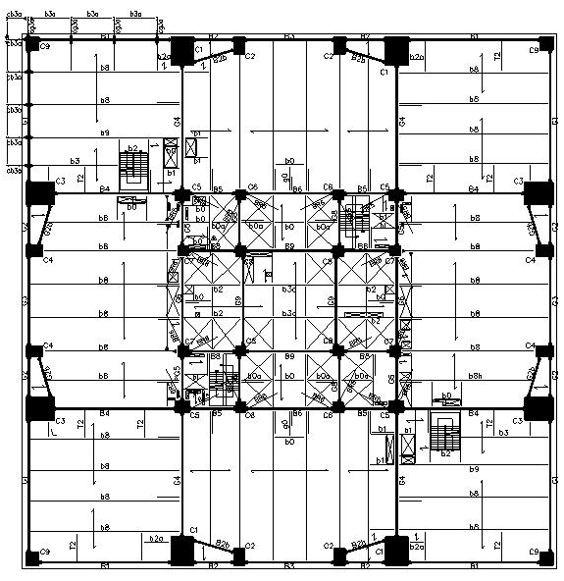
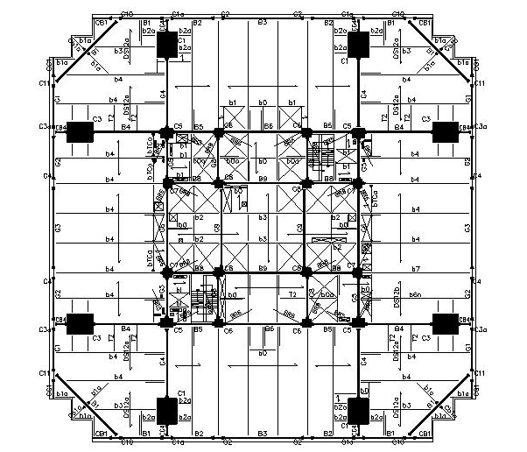
TYPICAL PLAN UP TO 26TH STOREY
TYPICAL PLAN FROM 27TH TO 91ST STOREY

Slide 23
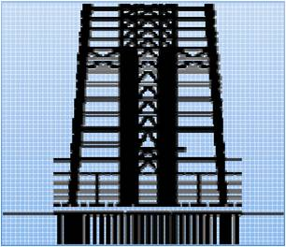
Lateral Loading System
For additional core stiffness, the lowest floors from basement to the 8th floor have concrete shear walls cast between core columns in addition to diagonal braces.
The most of the lateral loads will be resisted by a combination of braced cores, cantilevers from the core to the perimeter, the super columns and the Special moment resisting frame (SMRF).

Slide 24
The cantilevers (horizontal trussed from the core to the perimeter) occur at 11 levels in the structure. 5 of them are double storey high and the rest single storey.
16 of these members occur on each of such floors.
The balance of perimeter framing is a sloping Special Moment Resisting Frame (SMRF), a rigidly-connected grid of stiff beams and H shape columns which follows the tower’s exterior wall slope down each 8 story module.
At each setback level, gravity load is transferred to ‘super-columns’ through a story-high diagonalized truss in the plane of the SMRF.
Above the 26th floor, only two exterior super-columns continue to rise up to the 91st floor, so the SMRF consists of 600 mm deep steel wide flange beams and columns, with columns sized to be significantly stronger than beams for stability in the event of beam yielding.
Each 7-story of SMRF is carried by a story-high truss to transfer gravity and cantilever forces to the super-columns, and to handle the greater story stiffness of the core at cantilever floors.

Slide 25
Damping System
The main objective of such a system is to supplement the structures damping to dissipate energy and to control undesired structural vibrations.
A common approach is to add friction or viscous damping to the joints of the buildings to stabilize the structural vibration.
A large number of dampers may be needed in order to achieve effective damping when the movements of the joints are not sufficient to contribute to energy absorption.

Slide 26
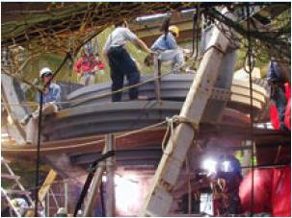
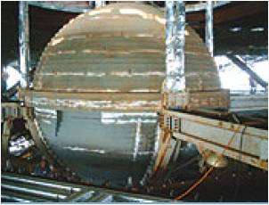
Tuned Mass Damper
A TMD is a passive damping system, which consists of a spring, a viscous damping device, and a secondary mass attached to the vibrating structure
By varying the characteristics of the TMD system, an opportunity is given to control the vibration of the primary structure and to dissipate energy in the viscous element of the TMD.
The Taipei 101 uses a 800 ton TMD which occupy 5 of its upper floors (87 – 91).
The ball is assembled on site in layers of 12.5-cm-thick steel plate. It is welded to a steel cradle suspended from level 92 by 3” cables, in 4 sets of 2 each.

Slide 27
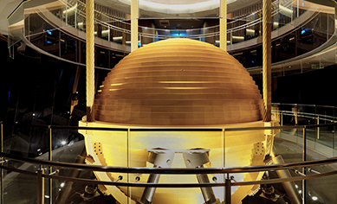
Eight primary hydraulic pistons, each about 2 m long, grip the cradle to dissipate dynamic energy as heat.
A roughly 60-cm-dia pin projecting from the underside of the ball limits its movement to about 1 m even during times of the strongest lateral forces.
The 60m high spire at the top has 2 smaller ‘flat’ dampers to support it.

Slide 28
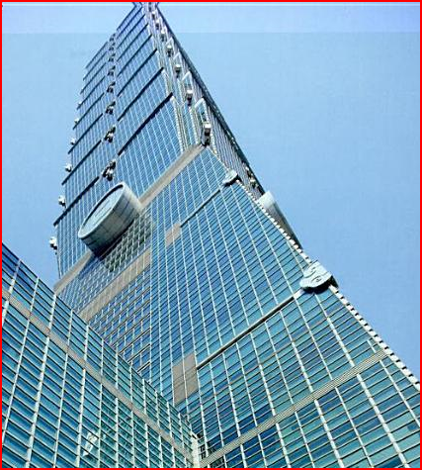
Structural facade
Taipei 101's characteristic blue-green glass curtain walls are double paned and glazed
They offer heat and UV protection sufficient to block external heat by 50 percent, and can sustain impacts of 7 tonnes
.The façade system of glass and aluminium panels installed into an inclined moment-resisting lattices contributes to overall lateral rigidity by tying back to the mega-columns with one-story high trusses at every eighth floor.
This façade system is therefore able to withstand up to 95mm of seismic lateral displacements without damage.

Slide 29
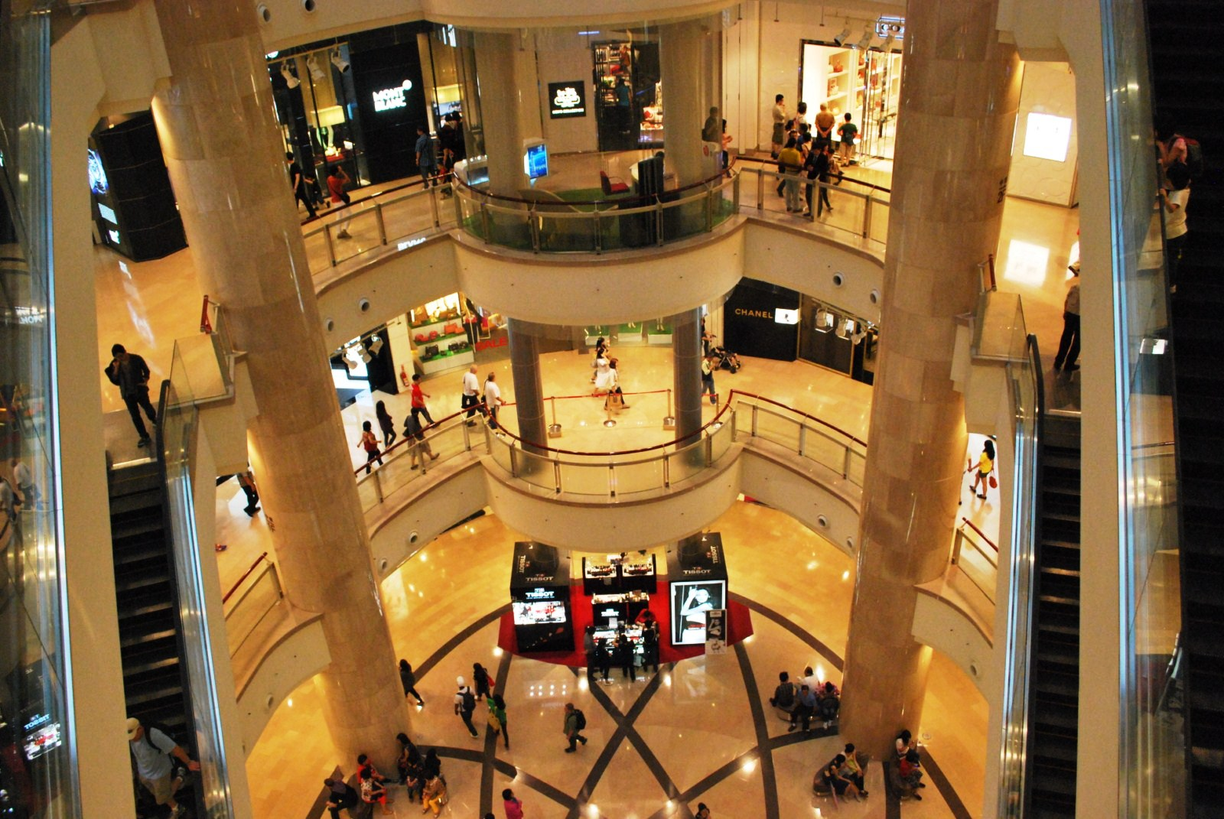
Interior
Taipei 101 is the first record-setting skyscraper to be constructed in the 21st century. It exhibits a number of technologically advanced features.
The original 2004 fibre-optic and satellite Internet connections permitted transfer speeds up to a gigabyte per second.
The double-deck elevators built by the Japanese Toshiba Elevator and Building Systems Corporation (TELC) set a new record in 2004 with top ascending speeds of 16.83 m (55.22 ft) per second .

Slide 30
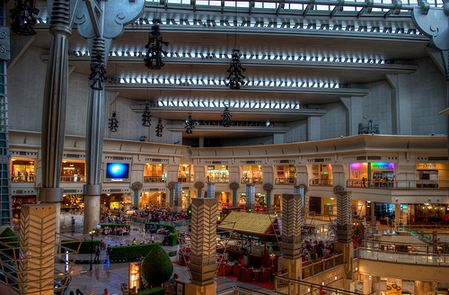
Taipei 101's elevators sweep visitors from the fifth floor to the 89th-floor observatory in only 37 seconds.
Each elevator features an aerodynamic body.
the world's first triple-stage anti-overshooting system. The cost for each elevator is NT$80 million (US$2.4 million).
The damper can reduce up to 40% of the tower's movements.
Two restaurants have opened on the 85th floor: Diamond Tony's,and Shin Yeh 101.
The multi-story retail mall adjoining the tower is home to hundreds of fashionable stores, restaurants, clubs and other attractions. The mall's interior is modern in design even as it makes use of traditional elements

Slide 31
History
Planning for Taipei 101 began in 1997 during Chen Shui-bian's term as Taipei mayor. Talks between merchants and city government officials initially cantered on a proposal for a 66-story tower to serve as an anchor for new development in Taipei's 101 business district. Planners were considering taking the new structure to a more ambitious height only after an expat suggested it, along with many of the other features used in the design of the building. It wasn't until the summer of 2001 that the city granted a license for the construction of a 101-story tower on the site. In the meantime, construction proceeded and the first tower column was erected in the summer of 2000.
A major earthquake took place in Taiwan during 31 March 2002 destroying a construction crane at the roof top, which was at floor number 47. The crane fell down onto the Xinyi Road beneath the tower, crushing several vehicles and causing five deaths – two crane operators and three workers who were not properly harnessed. However, an inspection showed no structural damage to the building, and construction work was able to restart within a week.
Taipei 101's roof was completed three years later on 1 July 2003.
The formal opening of the tower took place on New Year's Eve 2004. Open-air concerts featured a number of popular performers. Visitors rode the elevators to the Observatory for the first time. A few hours later the first fireworks show at Taipei 101 heralded the arrival of a new year.

Slide 32
Conclusion
Taipei 101 is a record breaking extraordinary structure which has been the tallest building in the world from 2004-2010 over-coming the height of Petronas Towers by 58m. It has been the symbol of excellence and technology for Taiwan. It is the structure which is flexible enough to withstand earthquake and strong enough to resist typhoon winds. The engineers and the designers of Taipei 101 have gone beyond the expectations and imagination of human mind to construct this mega marvel. There are many mega-structures under construction and being constructed but Taipei 101 still maintains its uniqueness and variation.

Slide 33
Reference
Ingredient of High-Rise Design Structure Magazine, June 2006
Taipei 101 at Skyscraper Page
Taipei 101 at Structure
Taipei 101 Official Website – Lights Schedule
LEED certified: The tallest "green" building in the world Siemens Building Technologies

Slide 34
Thank you for watching
Name: Abheek Khajuria
Class : TE Civil
Division: B
Roll No: 32

